Slide 1
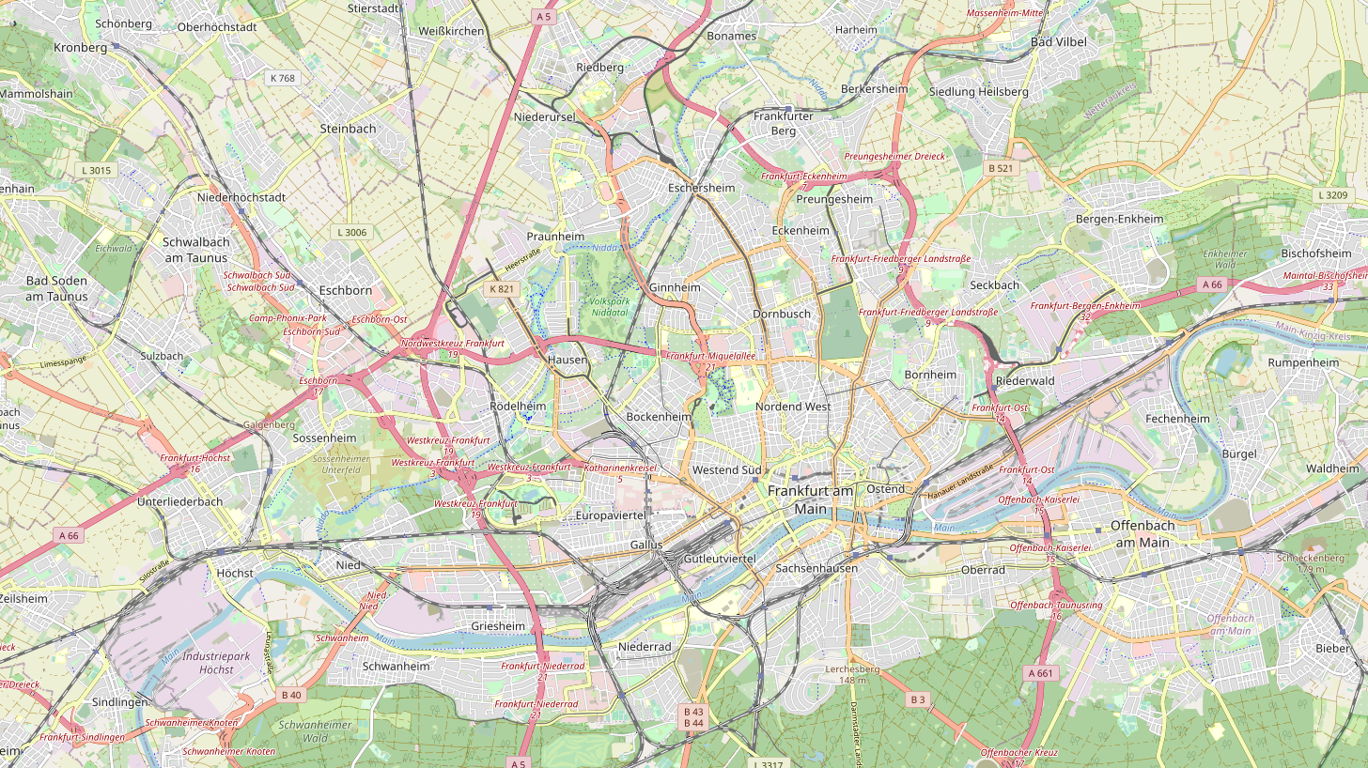
DC (AZ2)
IBM Code : Frankfurt 4
Operator Code : Frankfurt1
E-Shelter
Eschborner Landstrasse 100
PoP
IBM Code : Frankfurt 1
Operator: Digital Realty (fInterXion)
Operator Code : FRA01
Hanauer Landstrasse 302.
DC (AZ1)
IBM Code : Frankfurt 2
Operator Code : FRA1
Cyrus One (fZenium) Leonhard - Heisswolf Str 4.
10km
3,5km
4km
11km
PoP
IBM Code : Frankfurt 3
Operator Code : FRA6
Equinix
Larchenstrasse 110
DC (AZ3)
IBM Code : Frankfurt 5
Operator : InterXion
Operator Code : FRA05
Weismüllerstraße 40

Slide 2
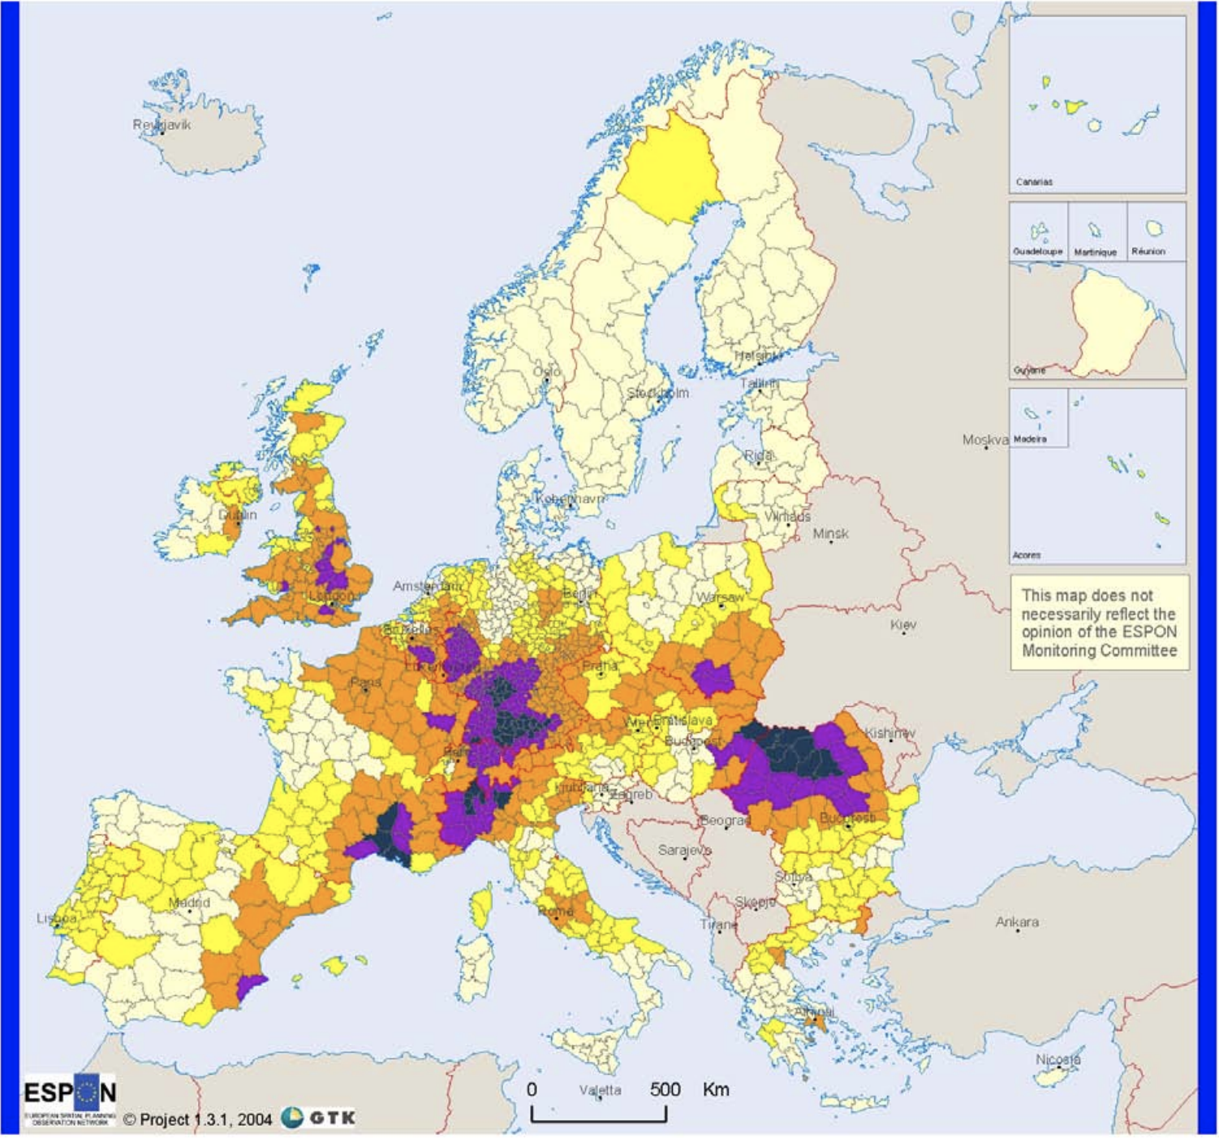
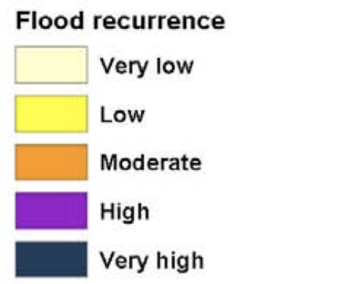
Floods

Slide 3
Elevation: 107m
Probable Water Level: 12m
Elevation: 103m
Probable Water Level: 16m
Elevation: 113m
Probable Water Level: 6m
Elevation: 96m
Probable Water Level: 23m

Slide 4
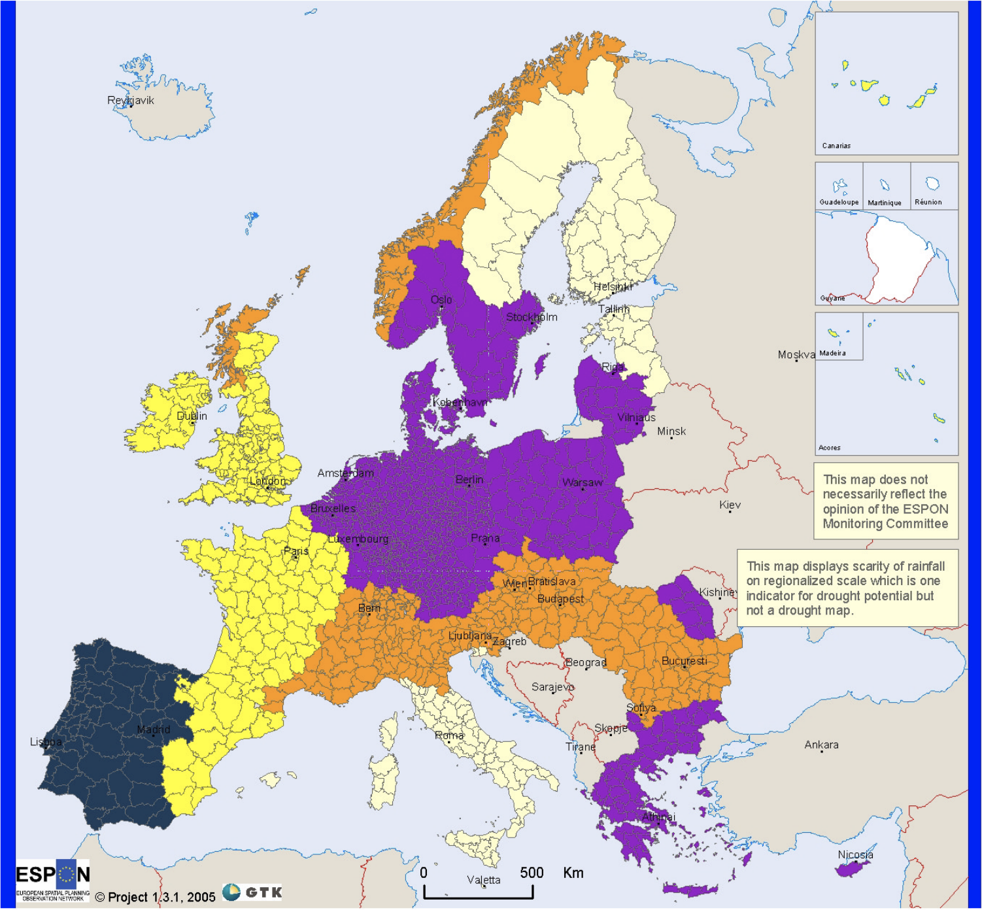
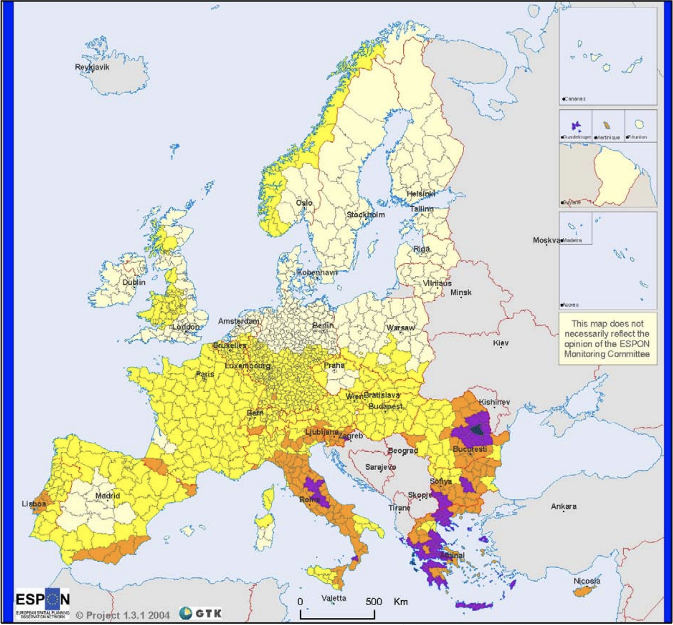
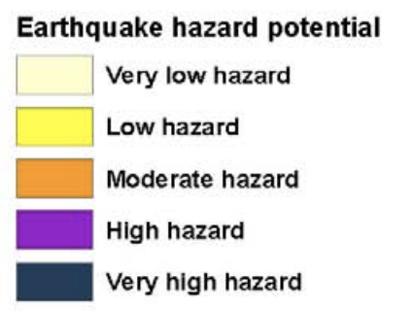
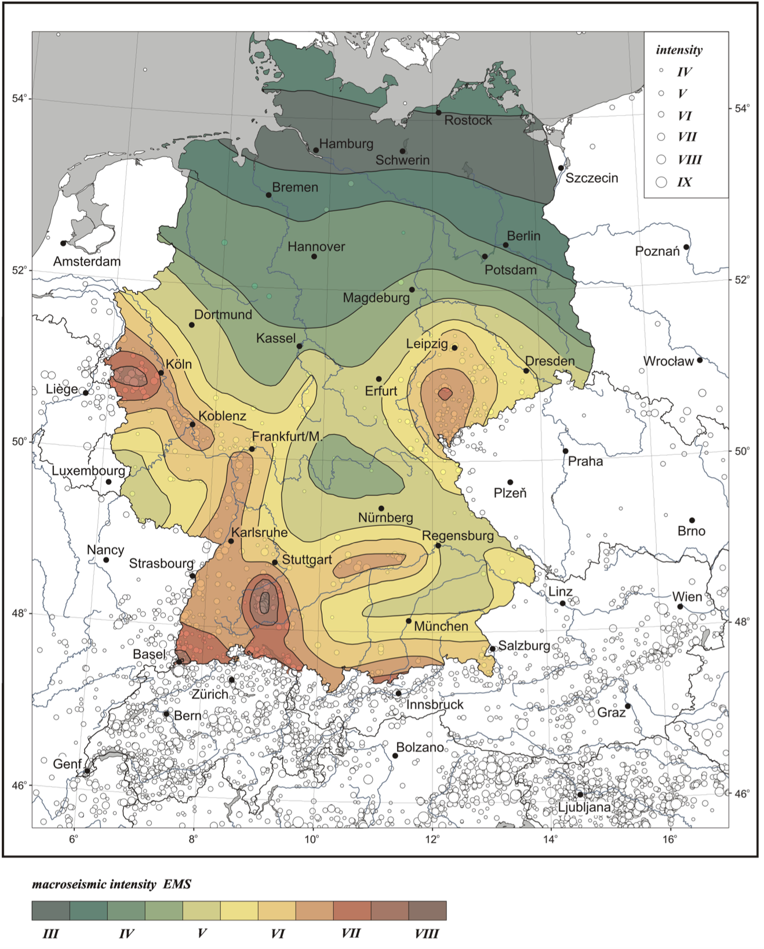
Earthquakes

Slide 5
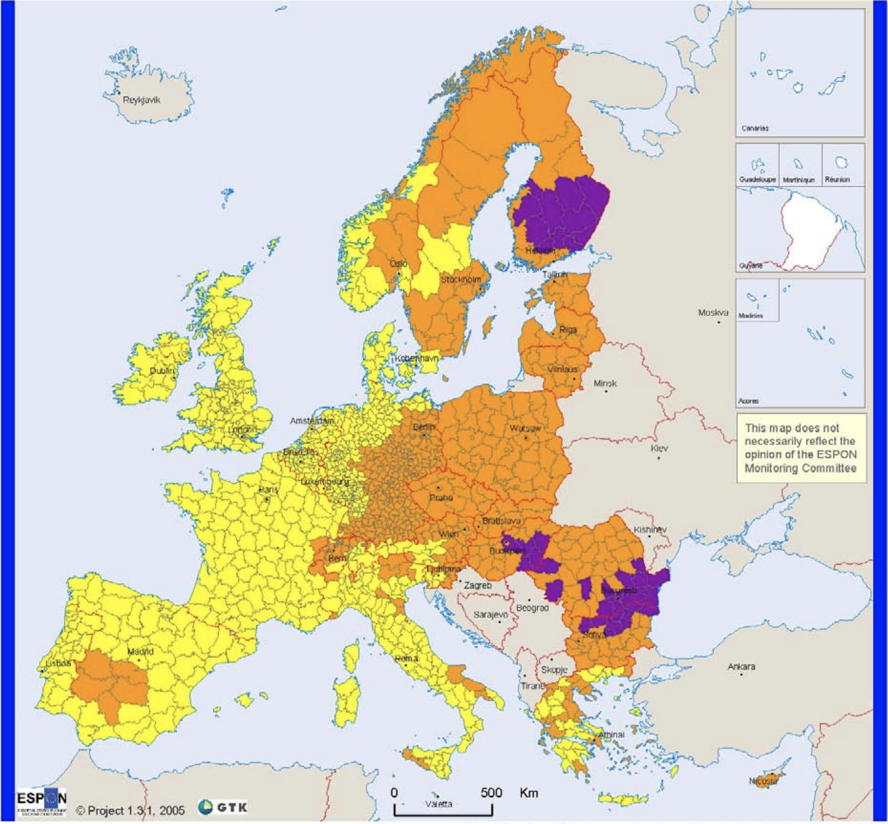
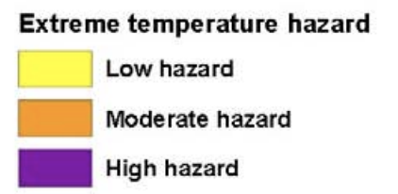
Extreme temperatures

Slide 6
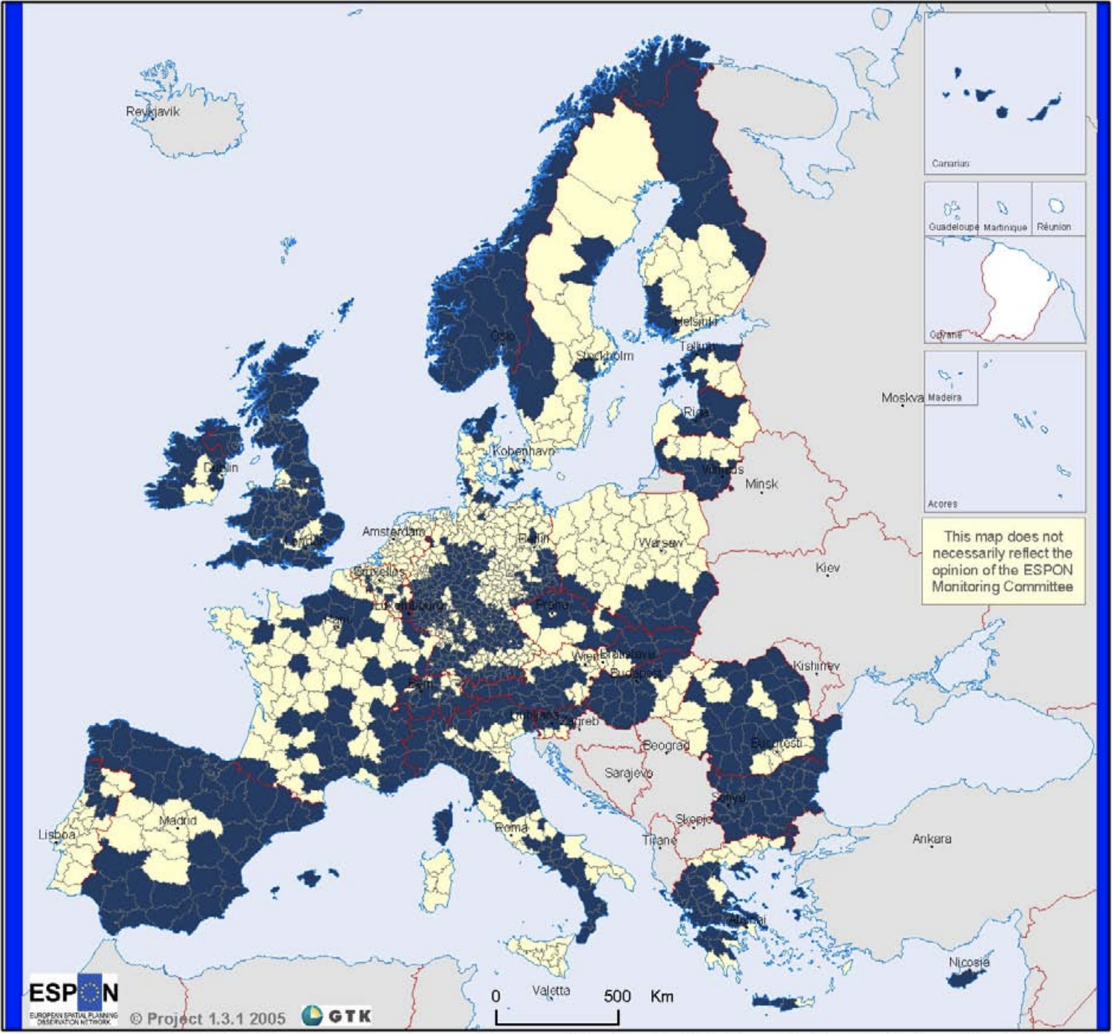
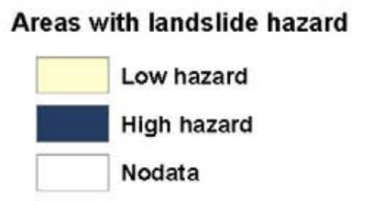
Landslides

Slide 7
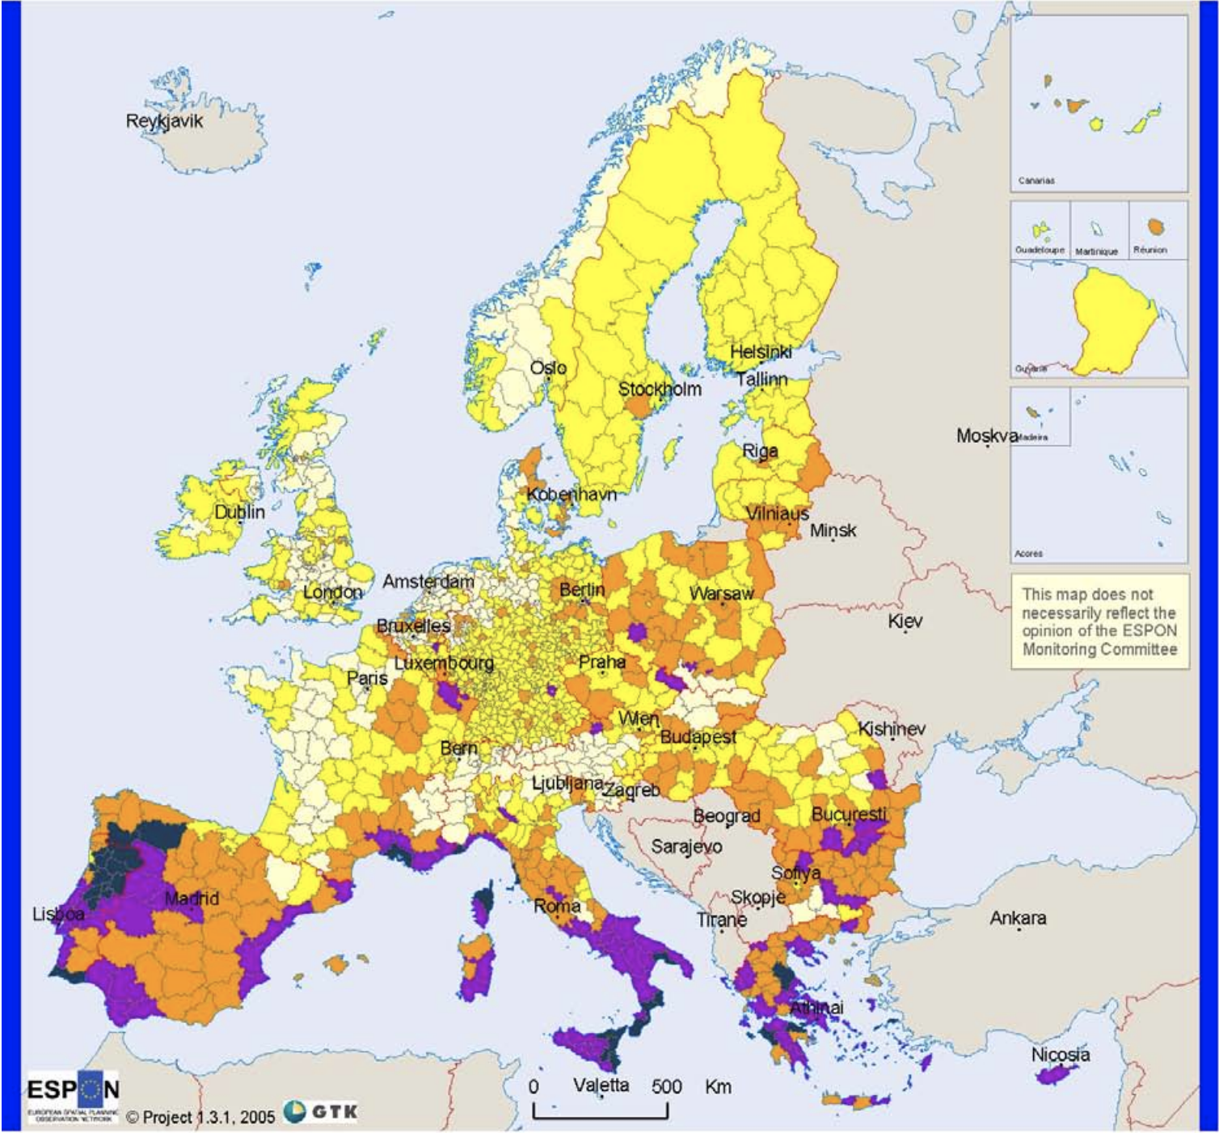
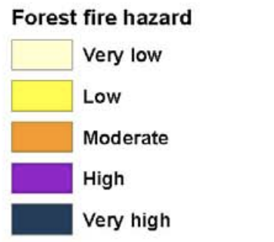
Forest fires

Slide 8
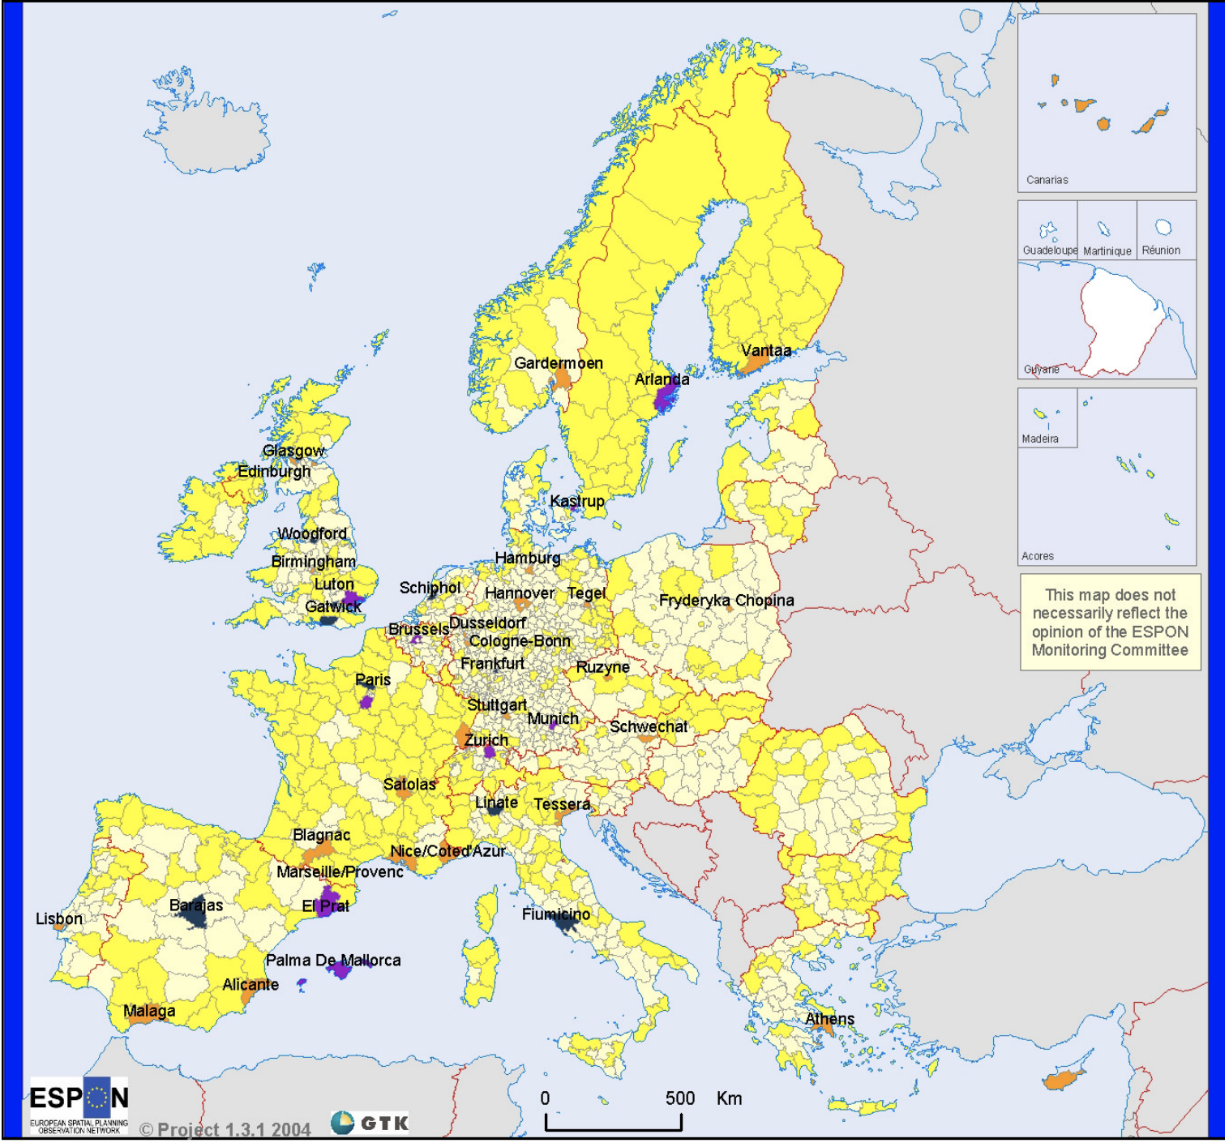
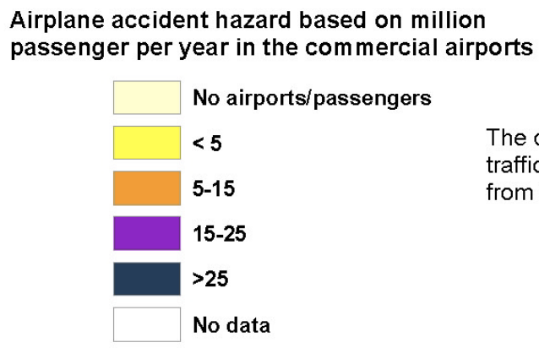
Air traffic

Slide 9
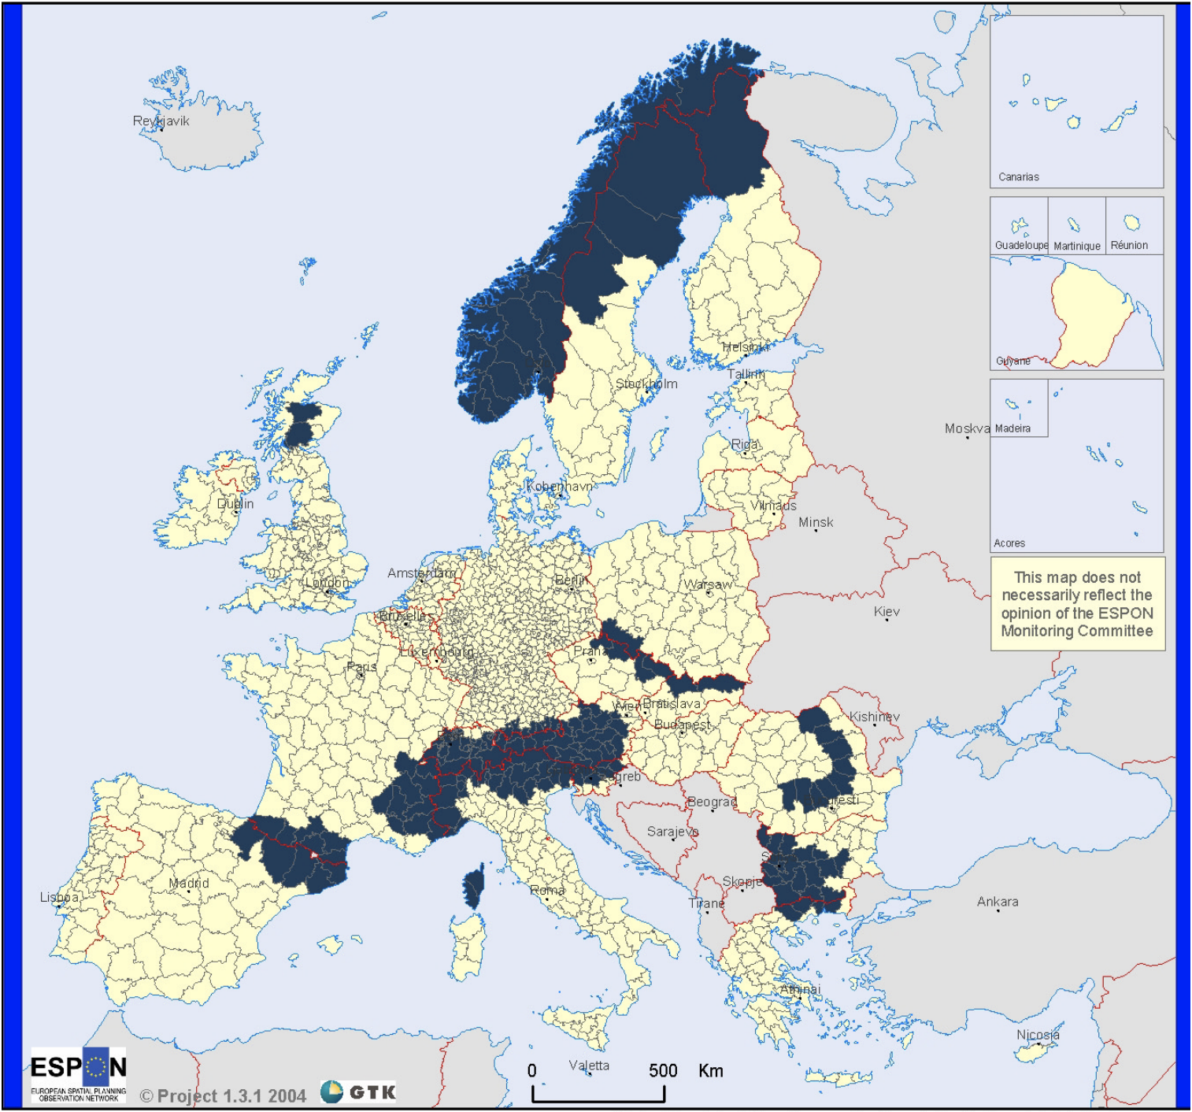
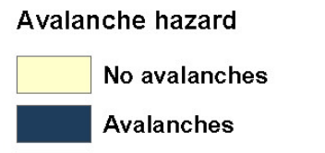
Avalanches

Slide 10
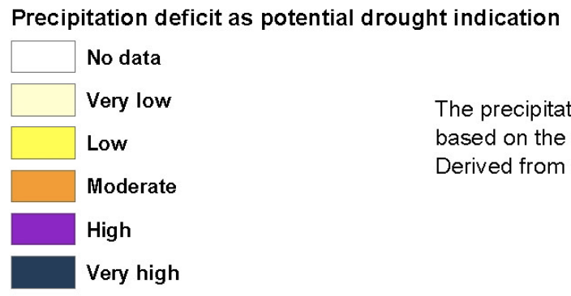
Precipitation deficit as drought potential indication

Slide 11
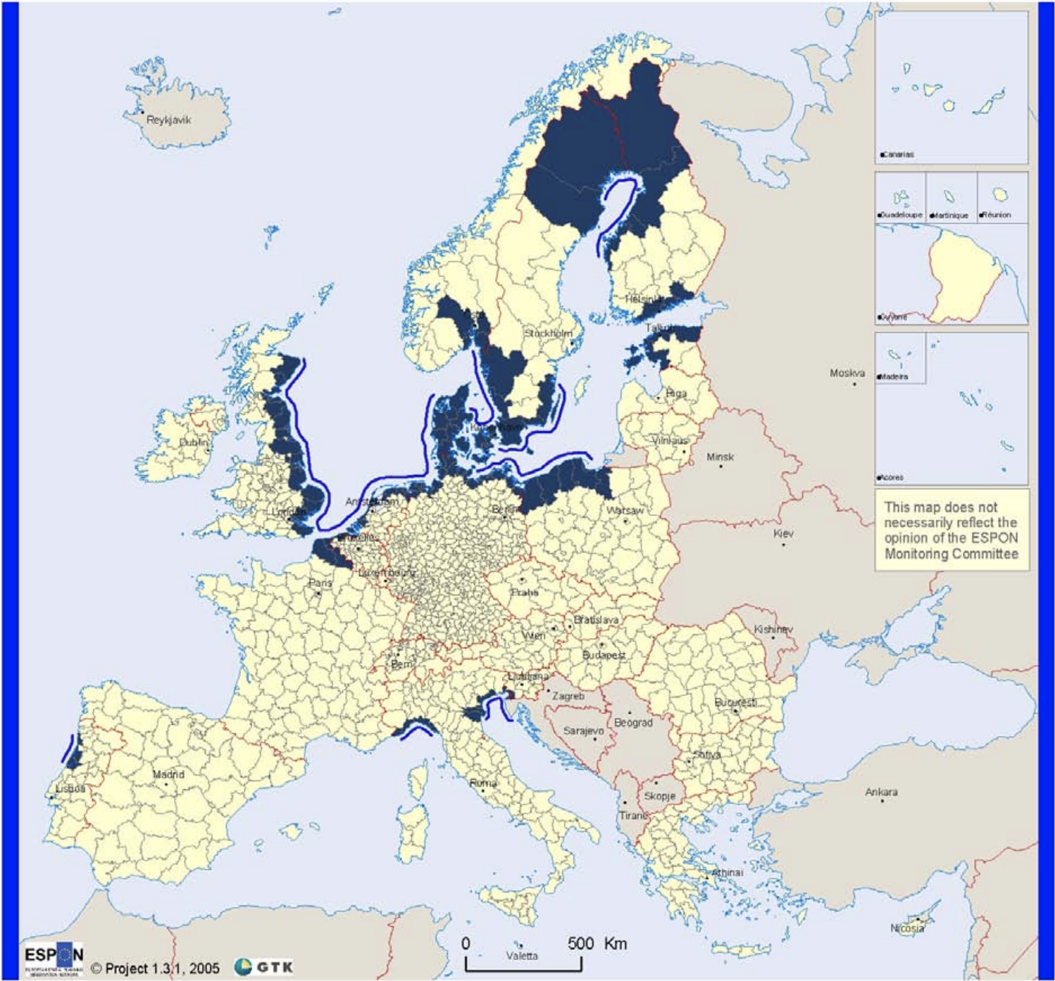
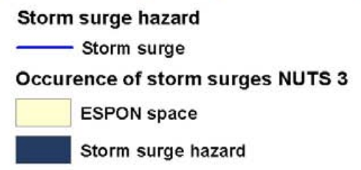
Storm surges

Slide 12
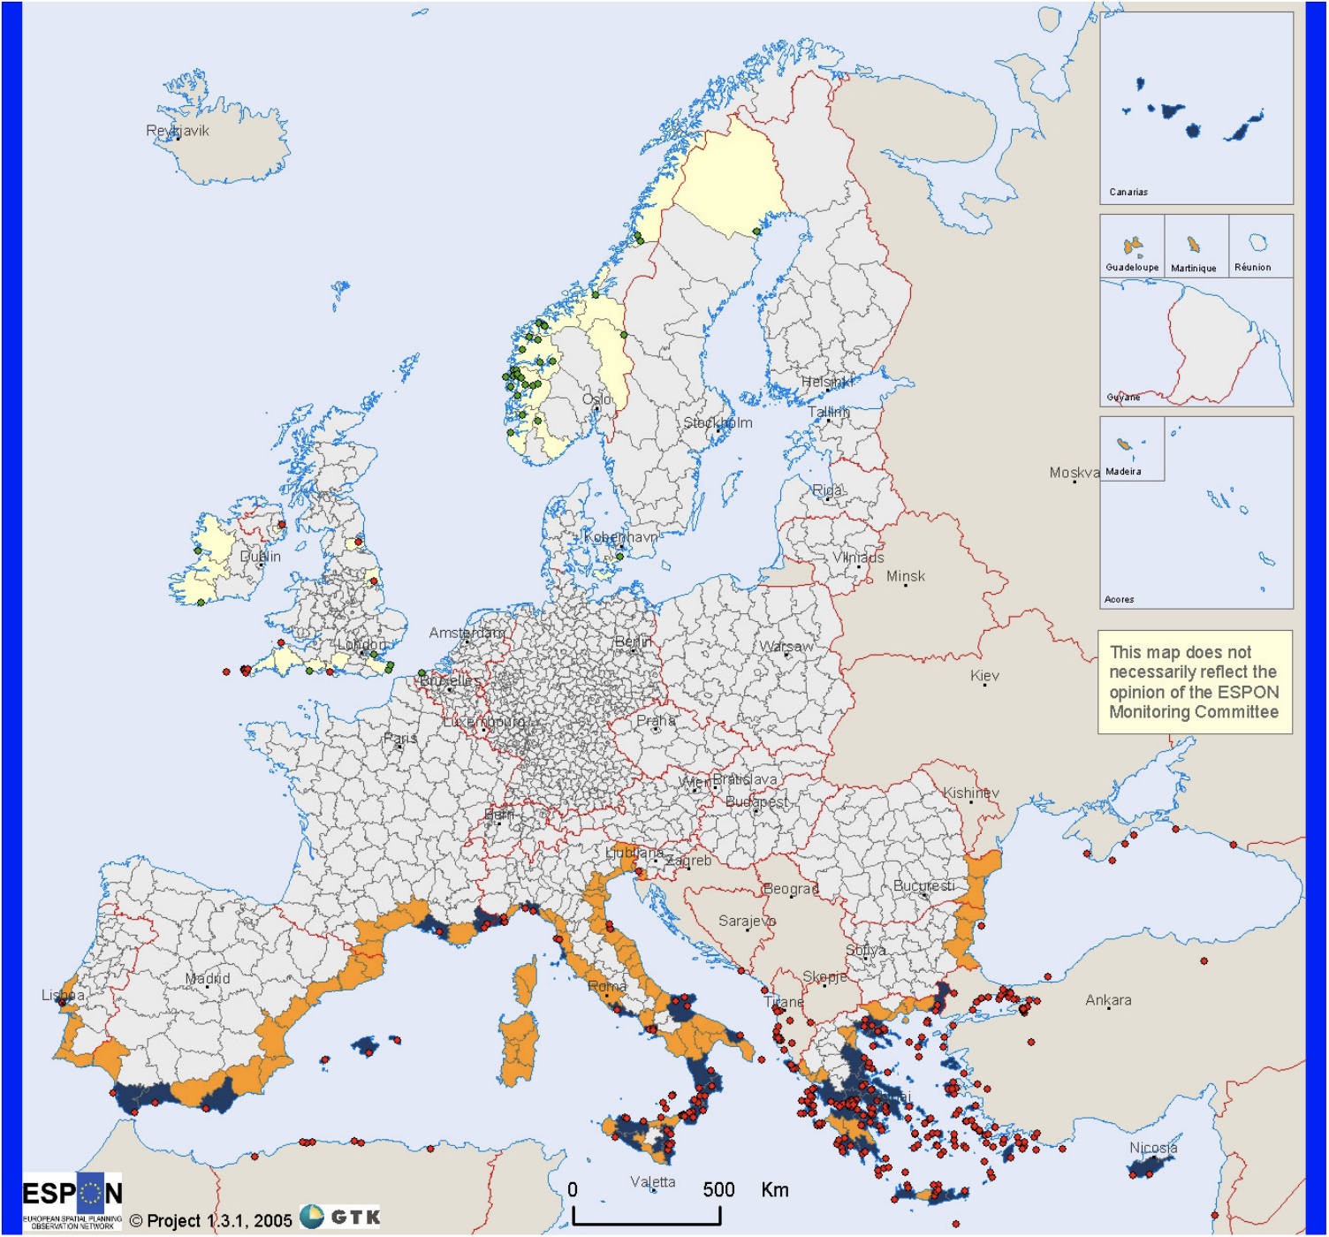
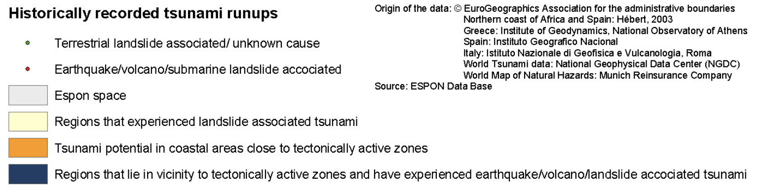
Tsunamis

Slide 13
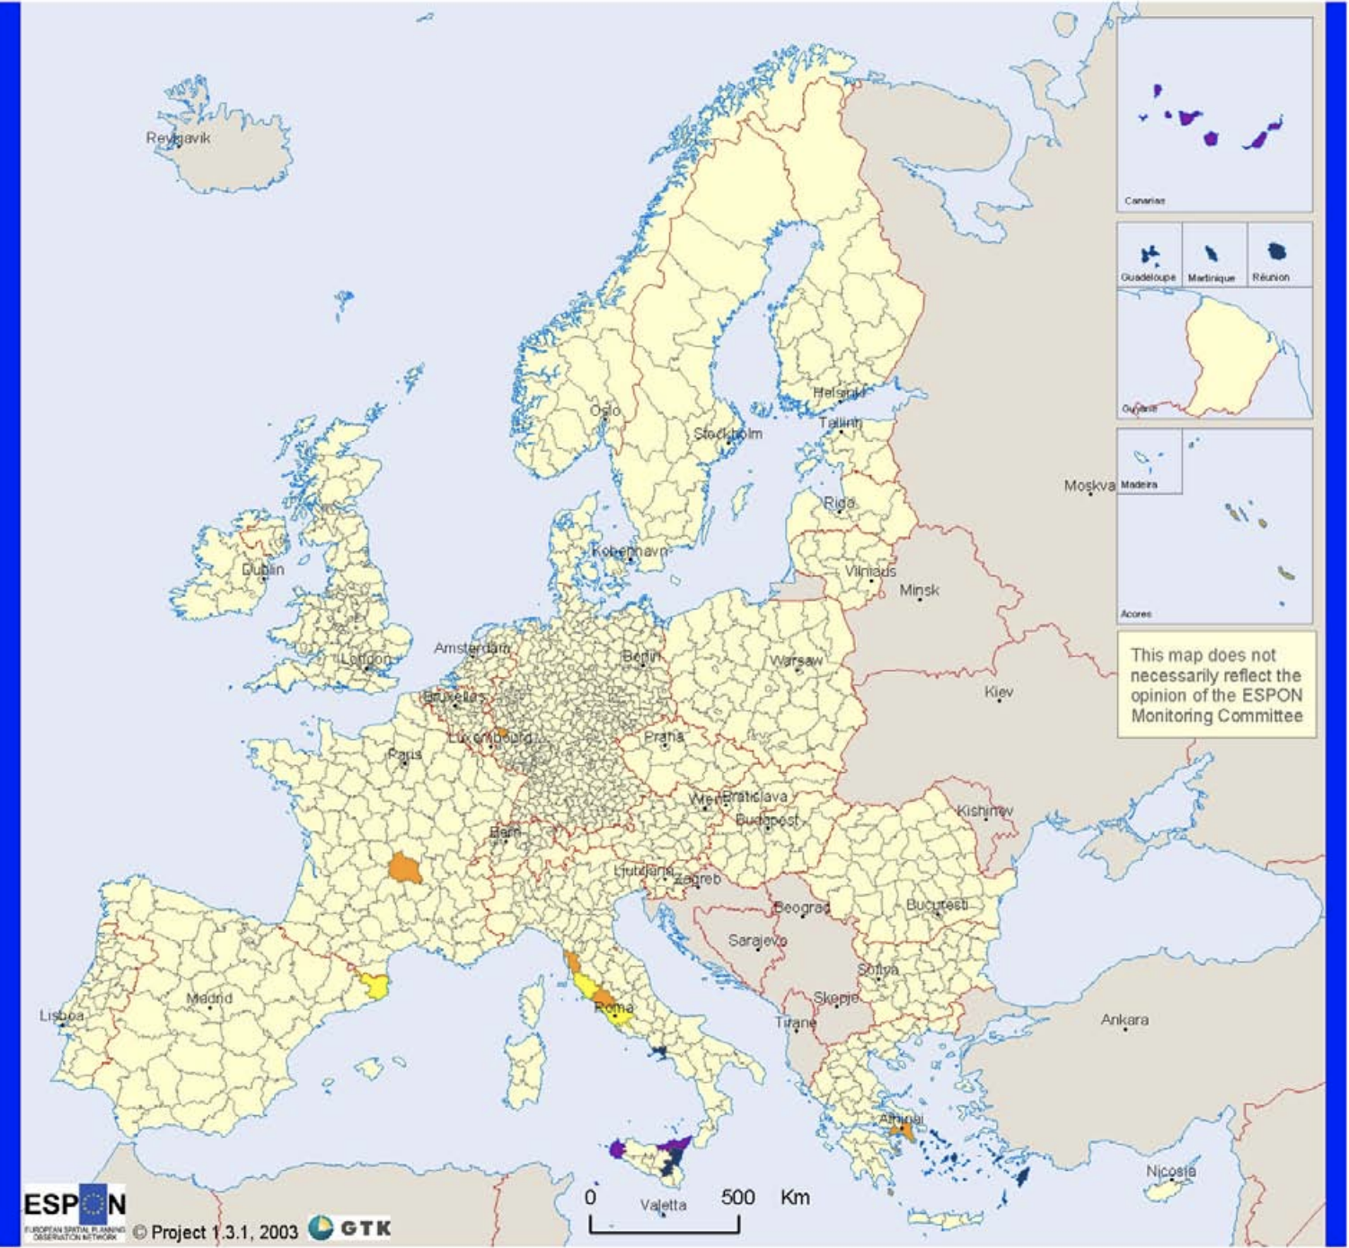
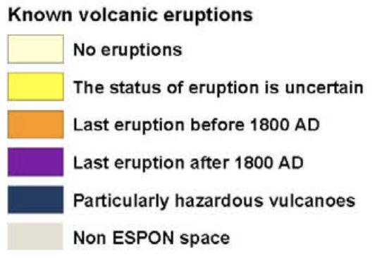
Volcanic eruptions

Slide 14
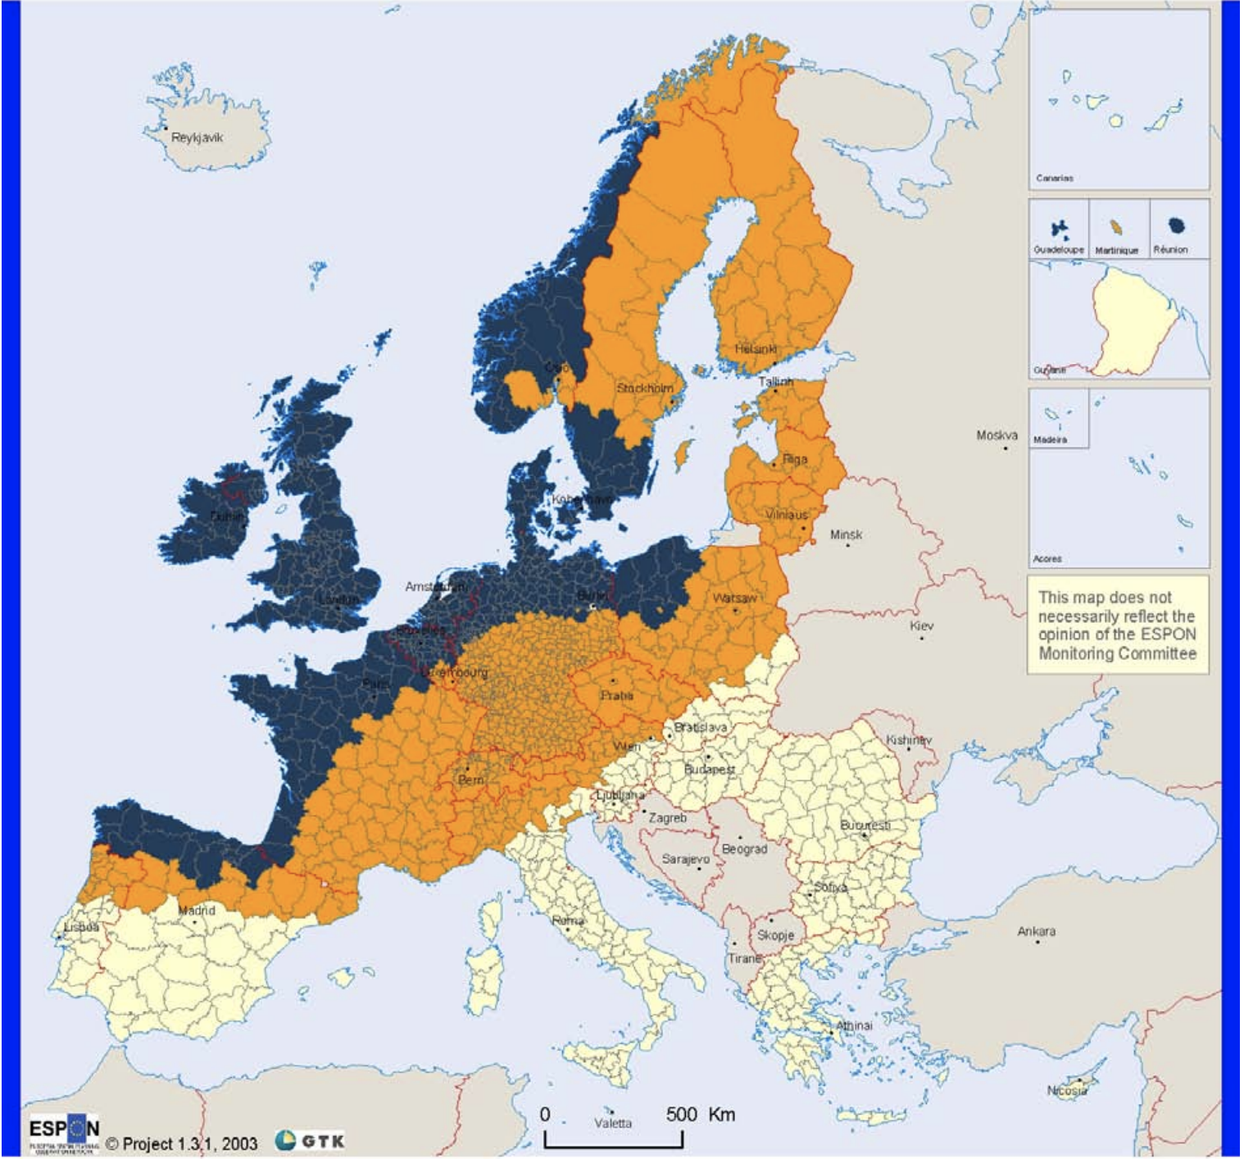
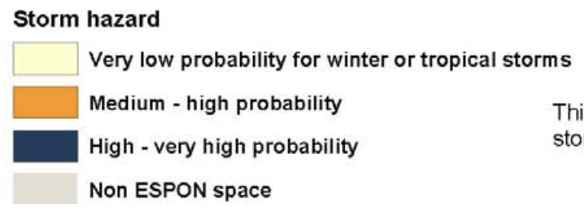
Winter storms

Slide 15
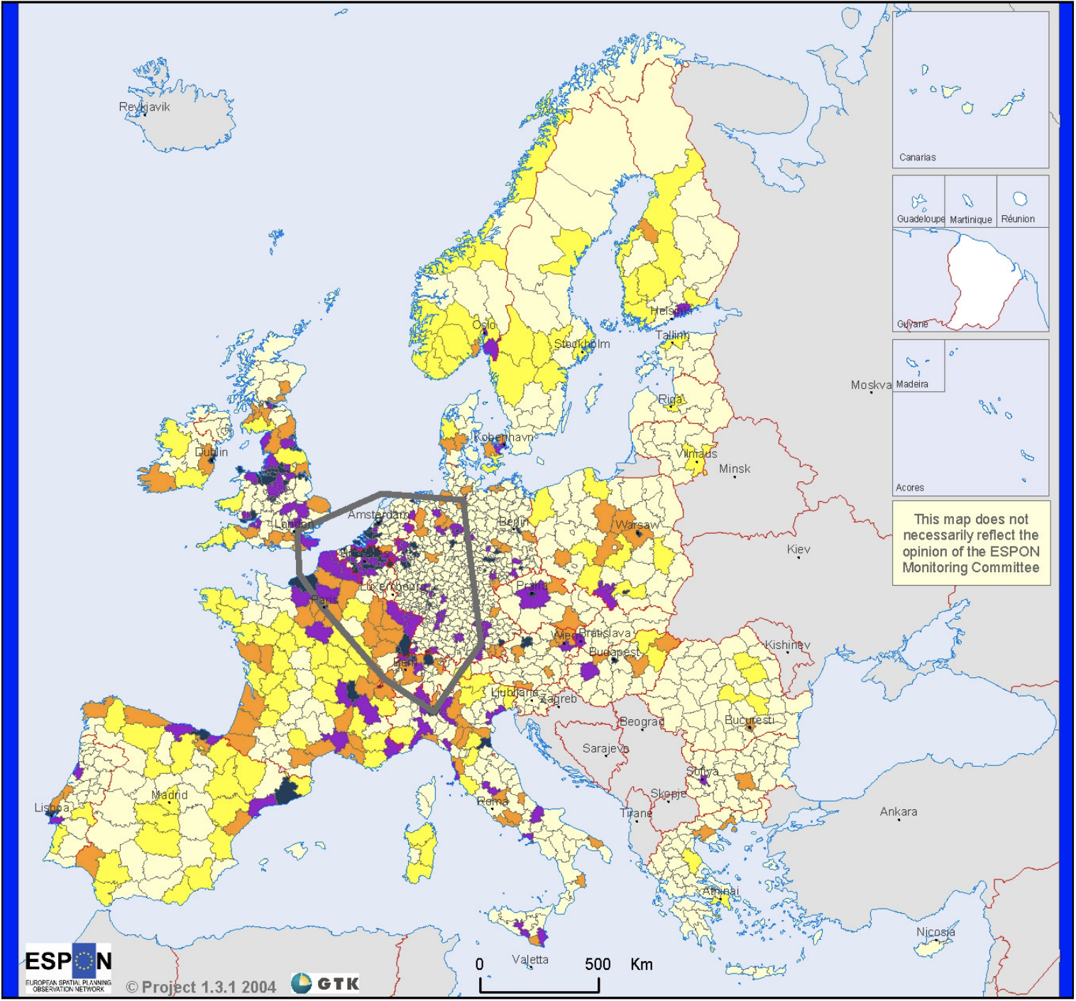
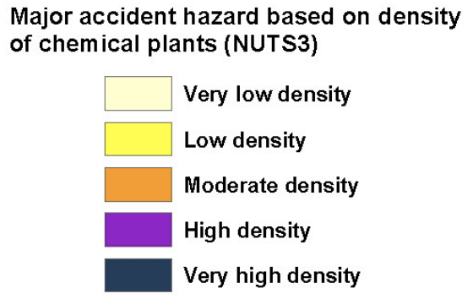
Chemical plants (as an example for major accident hazards)

Slide 16
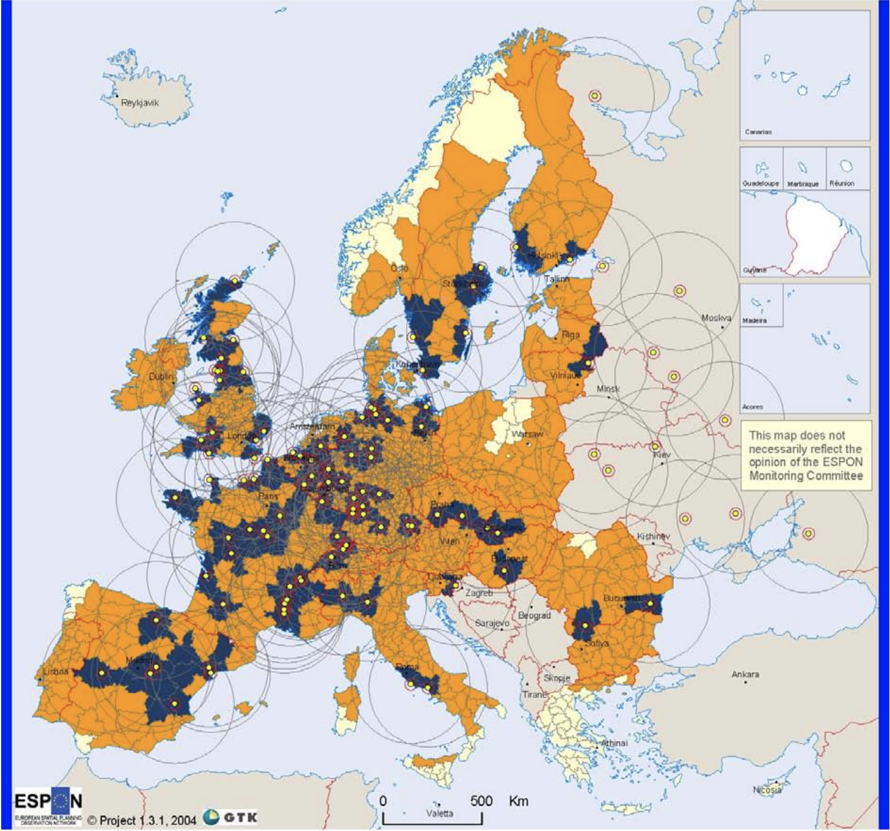
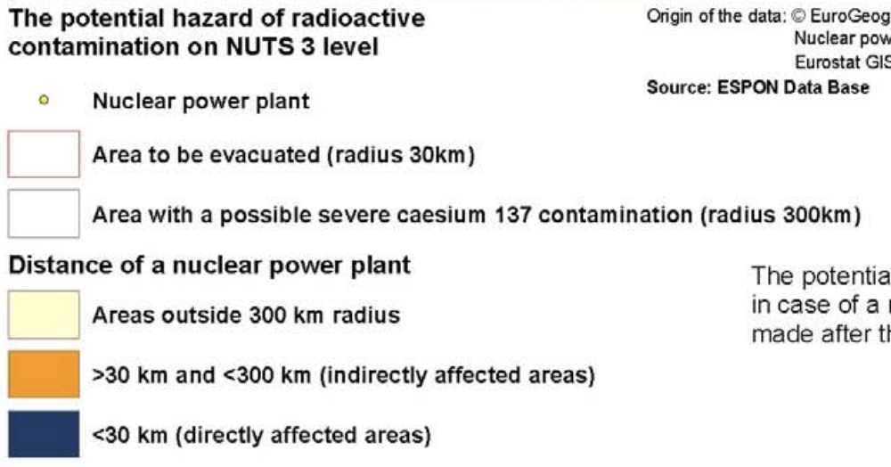
Nuclear power plants

Slide 17
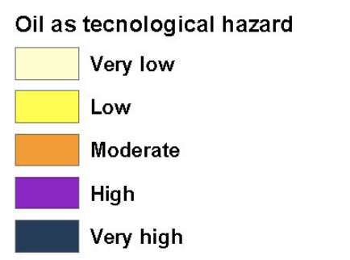
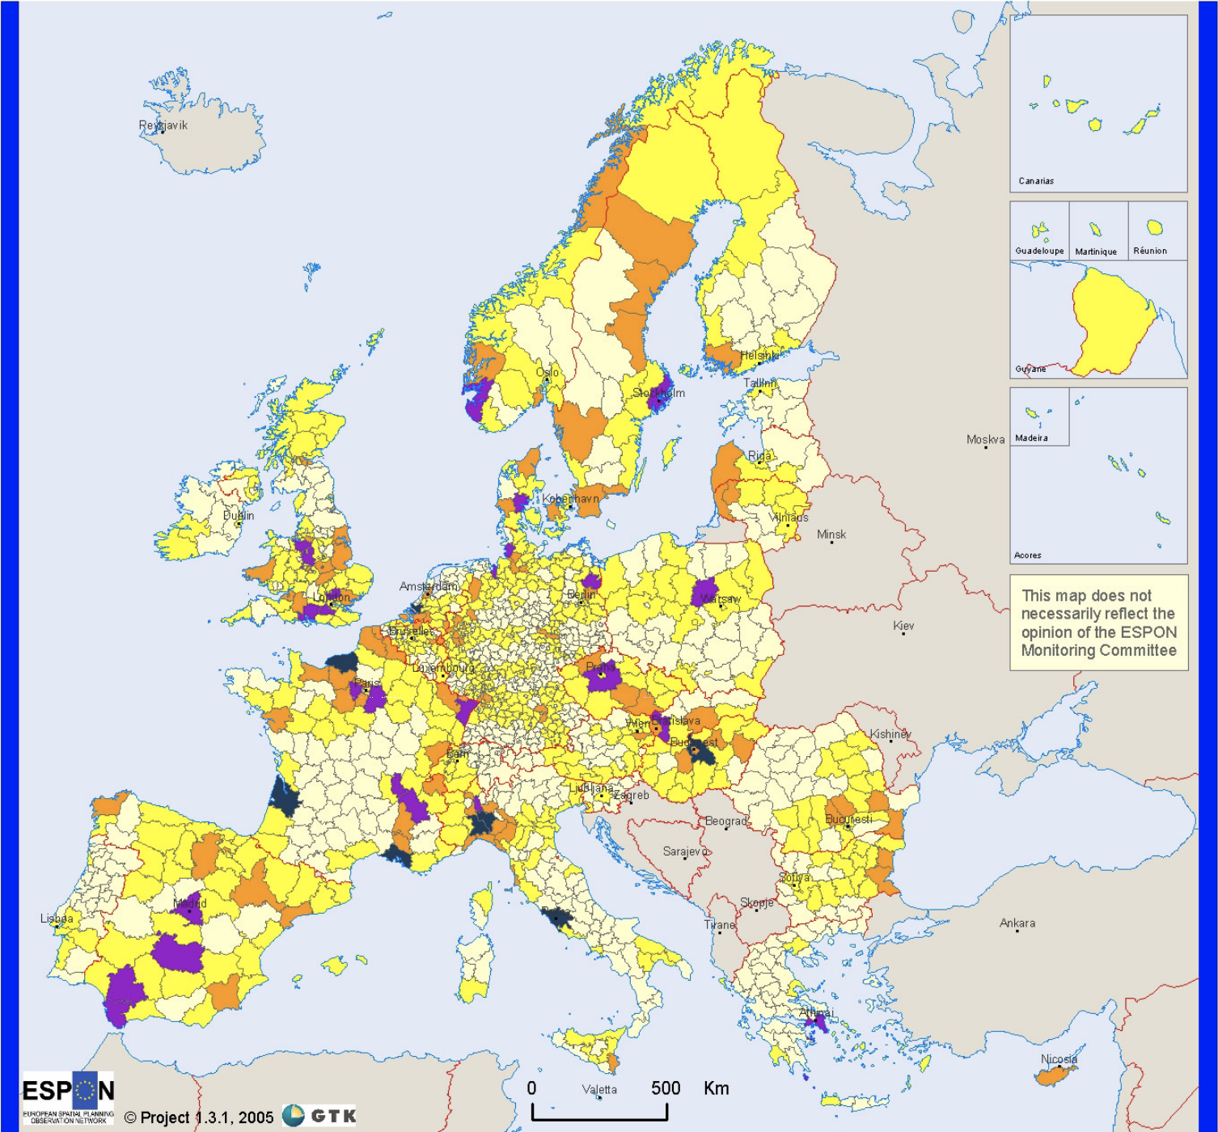

Slide 18

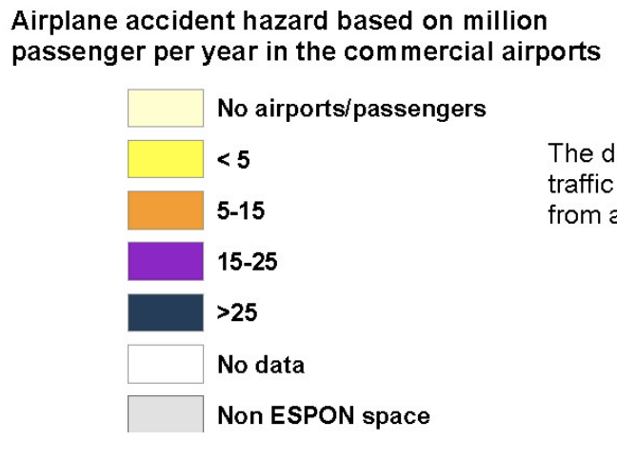
Air traffic

Slide 19
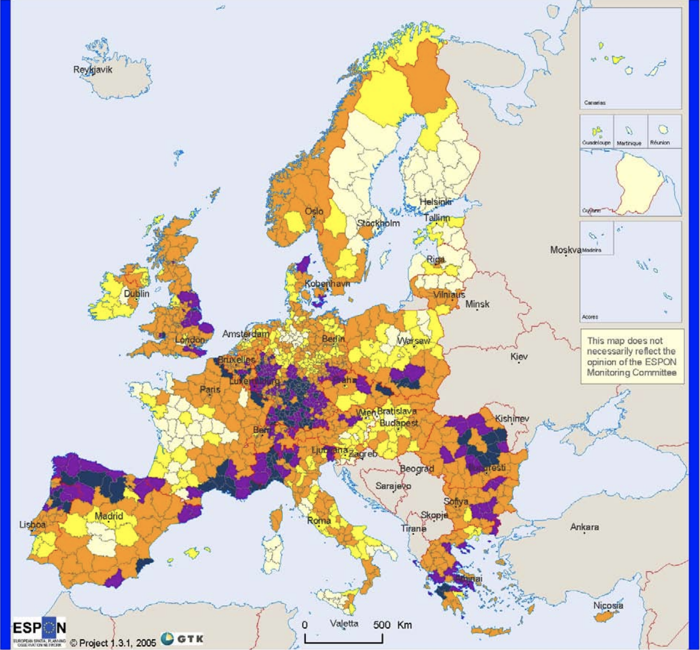
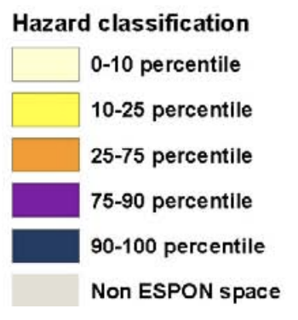
Aggregated natural hazard map

Slide 20
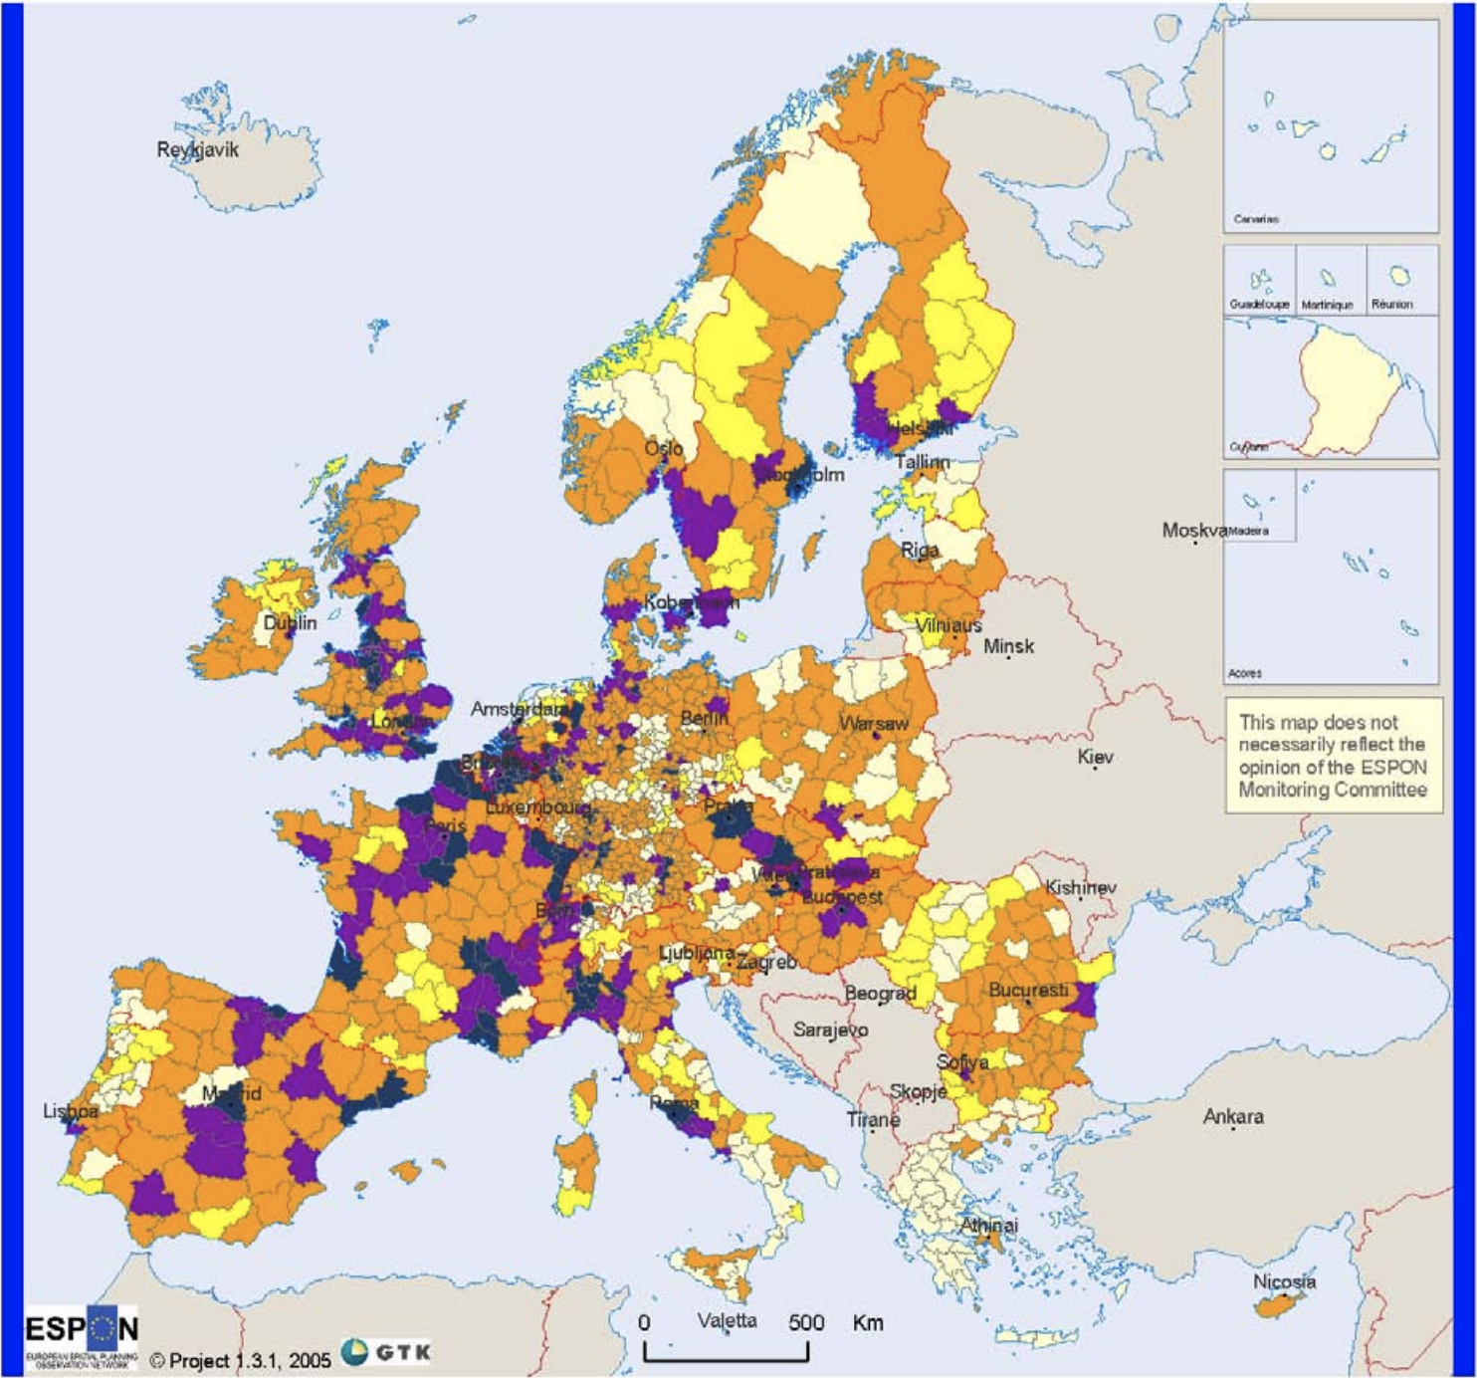
Aggregated technological hazard map

Slide 21
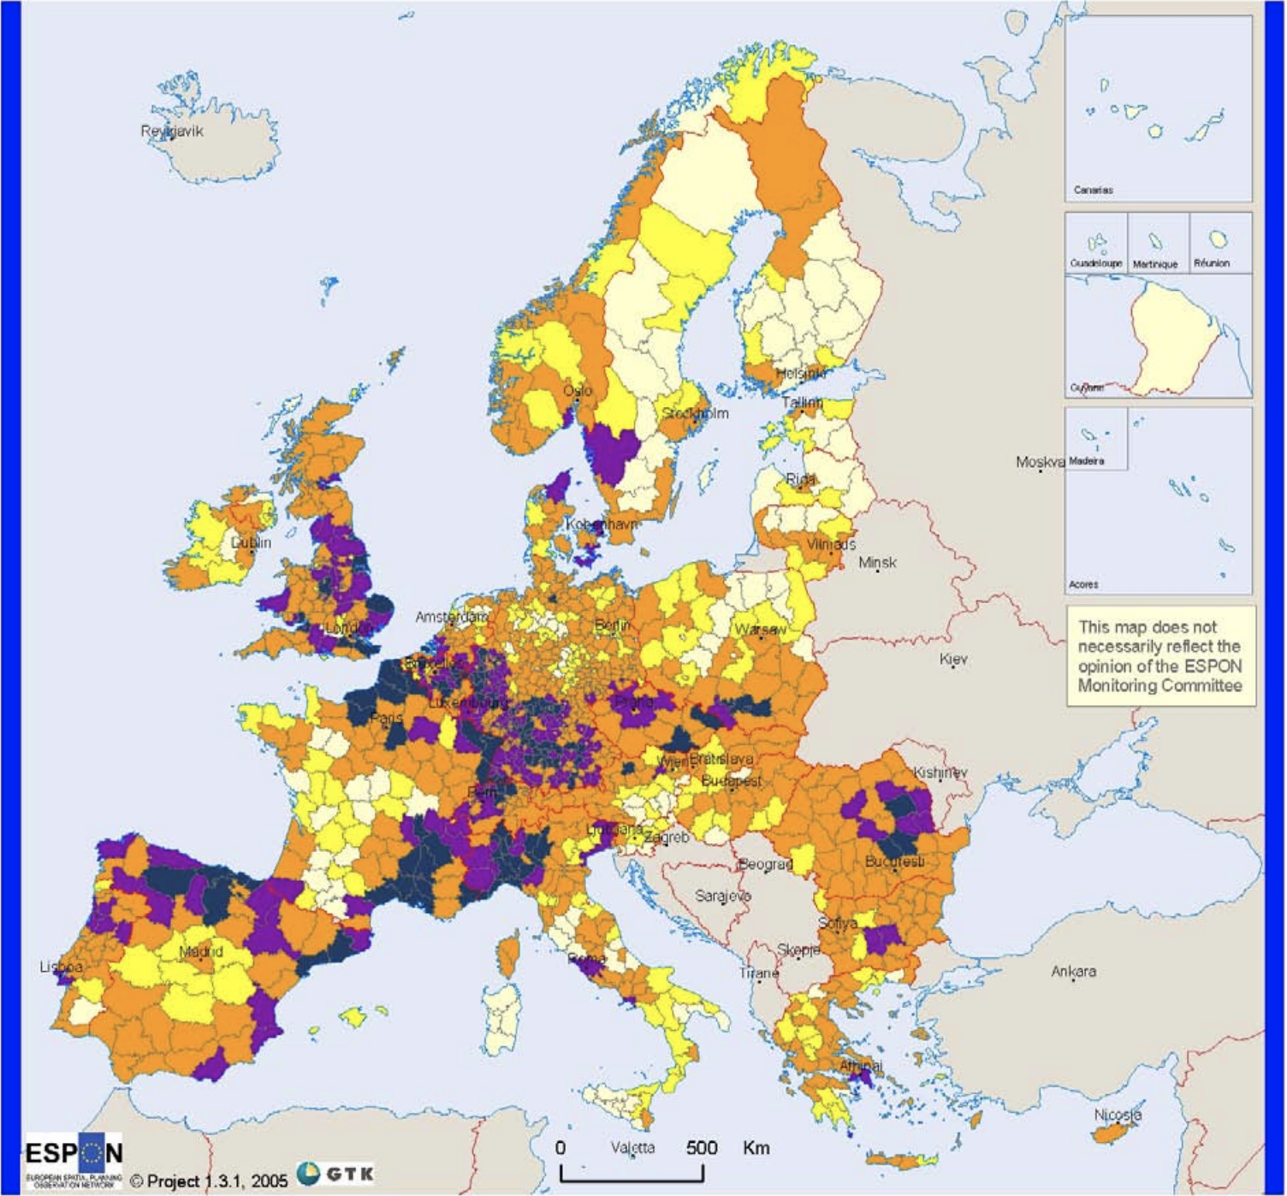
Aggregated hazard map

